Slide 1
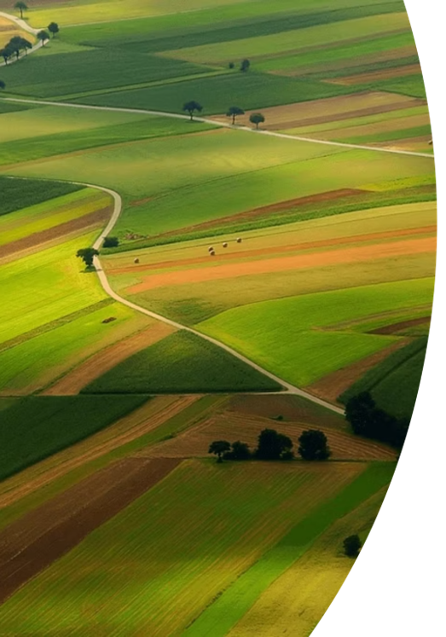
AgroBot
- A multilingual farming assistant

Slide 2
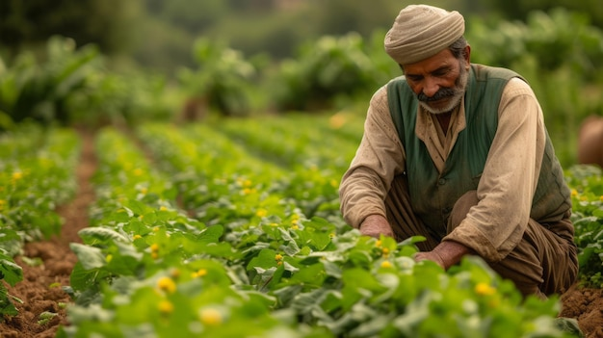
“Our AgroBot project seamlessly integrates Machine Learning technologies to provide comprehensive assistance to farmers. This innovative solution combines visual analysis with natural language understanding, breaking down communication barriers.
”

Slide 3
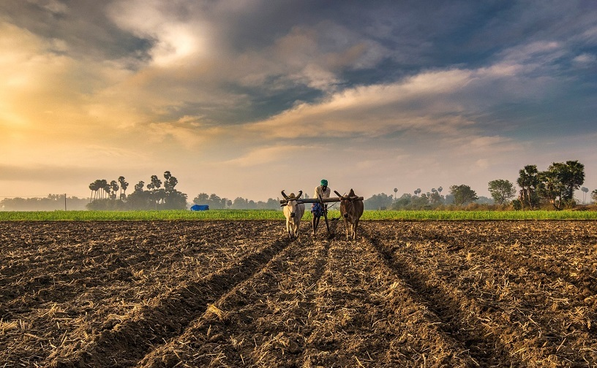
Problem Statement
Farmers struggle to identify crop diseases early, leading to crop damage and reduced yield.
Lack of immediate access to agricultural experts makes diagnosis difficult.
Most existing digital tools are limited to English, creating a language barrier for regional users.
Farmers need a quick and reliable platform for both image-based diagnosis and agricultural guidance.
Traditional methods of seeking help are slow, inconsistent, or inaccessible in rural areas.

Slide 4
Proposed Solution
Developed an assistant that combined image classification (CNN) and an NLP-based chatbot into a single system.
Used a CNN model to automatically detect crop diseases or issues from uploaded images.
Implemented an NLP chatbot to understand and answer agriculture-related queries.
Integrated multilingual support so farmers could interact in their native languages.
Used the Google Translator API for automatic language detection and translation.
Built a simple, user-friendly interface accessible to all users.

Slide 5
Convolutional Neural Network (CNN)
Why CNN was used
CNNs are highly effective for image-based classification tasks
Automatically extract visual patterns such as color, texture, shape, and disease spots
Perform better than traditional ML algorithms for crop image analysis
How CNN Works in AgroBot
Takes the uploaded crop image as input
Processes the image through convolution, pooling, and activation layers
Learns disease-related features during training
Outputs the predicted class
Role in the Project
Acts as the image diagnosis module
Helps farmers identify crop diseases automatically
Reduces dependency on agricultural experts

Slide 6
Natural Language Processing (NLP)
01
Why NLP Was Used
02
How NLP Works in AgroBot
To enable the system to understand user queries written in everyday language
Helps farmers ask questions naturally without using technical terms
Faster and simpler compared to heavy deep learning NLP models
User text is first cleaned and preprocessed
Query is compared with known symptom data using fuzzy matching (rapidfuzz)
The best-matching response is selected
Integrated with GoogleTranslator API for multilingual communication
03
Role in the Project
Acts as the chatbot engine of AgroBot
Provides instant answers to farming-related questions
Supports multiple Indian languages through translation APIs
Enhances accessibility for farmers across different regions

Slide 7
MODEL ARCHITECTURE
Output
Language detection and translation
Prediction
CNN model
Image
NLP model
Language detection and translation
Text

Slide 8




Tools and Technologies used
Frontend
Backend
TensorFlow / Keras – CNN image classification
rapidfuzz – fuzzy matching for NLP
SpaCy- for lemmatization
googletrans – Google Translate API
NumPy & PIL – image and numeric processing
Machine Learning
Python – main programming language
Flask – backend web framework used to serve routes and connect ML models
HTML – structure of the web interface
CSS – styling, layout, UI design
JavaScript (JS) – user interactions, dynamic behavior

Slide 9
Results
The CNN model successfully identified crop diseases with high accuracy during testing
The system correctly infected leaf images
The NLP chatbot responded accurately to common agricultural queries
Multilingual functionality performed well across Hindi, Bengali, Marathi, and other languages
Translation system correctly converted both user queries and chatbot responses
Overall system performance was stable, fast, and user-friendly

Slide 10
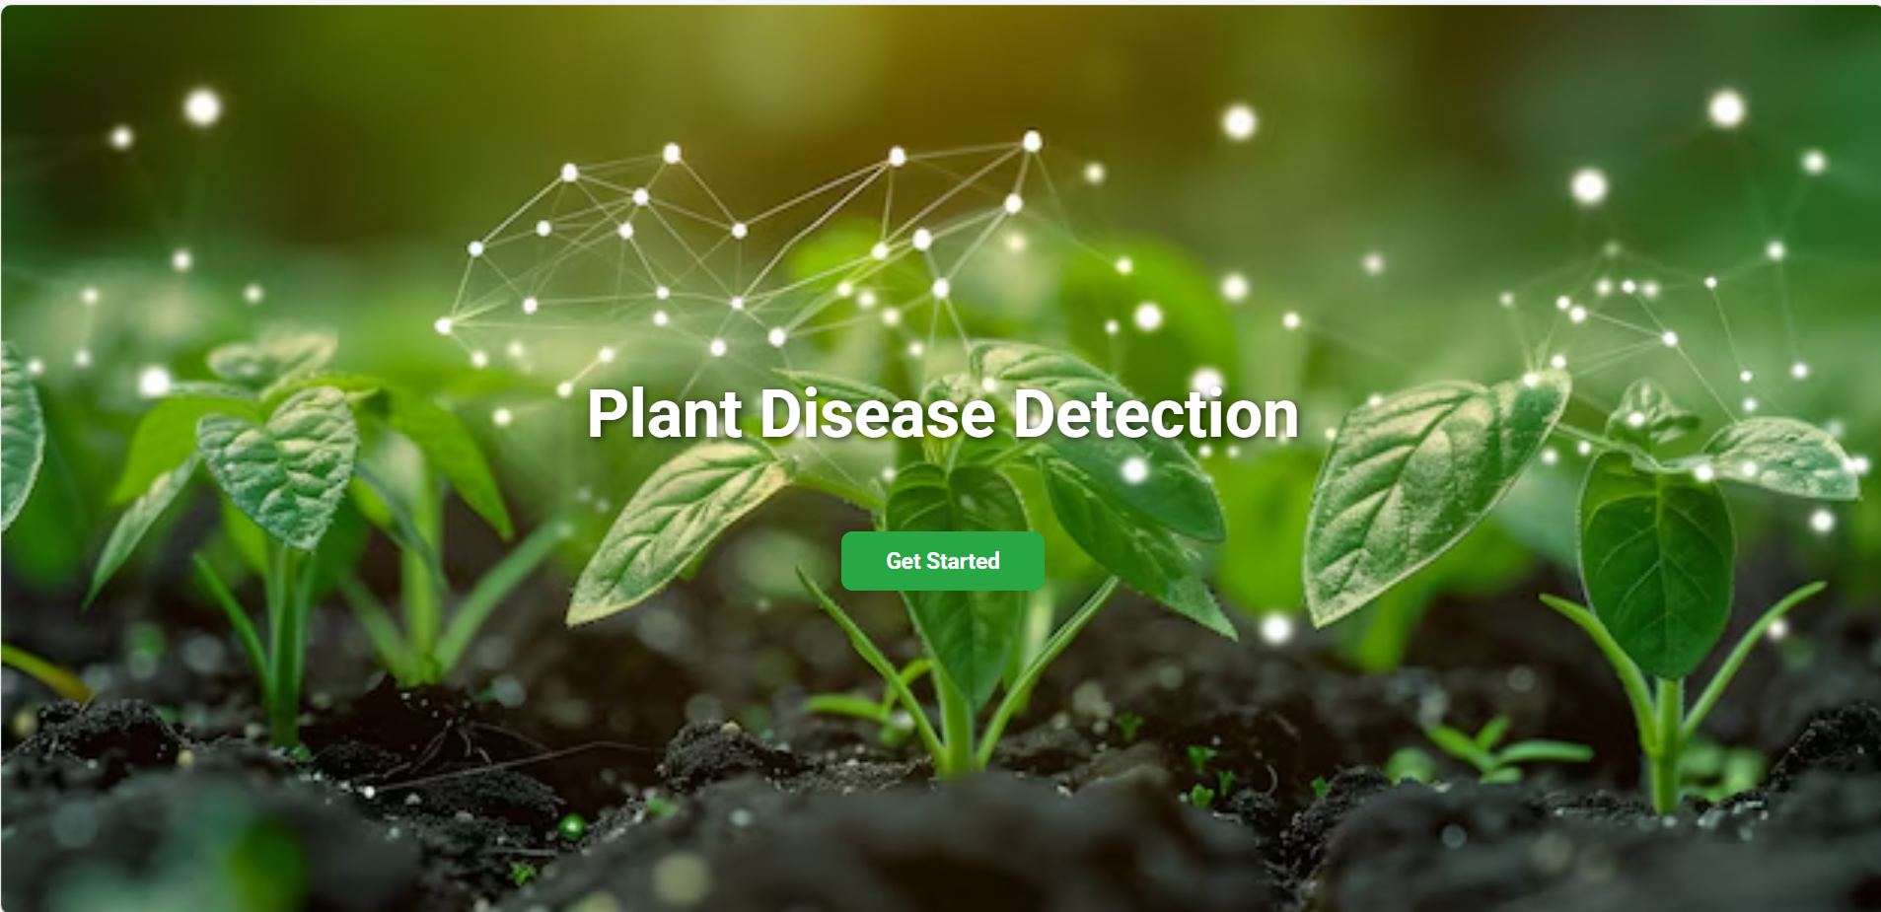
Output Screenshots

Slide 11
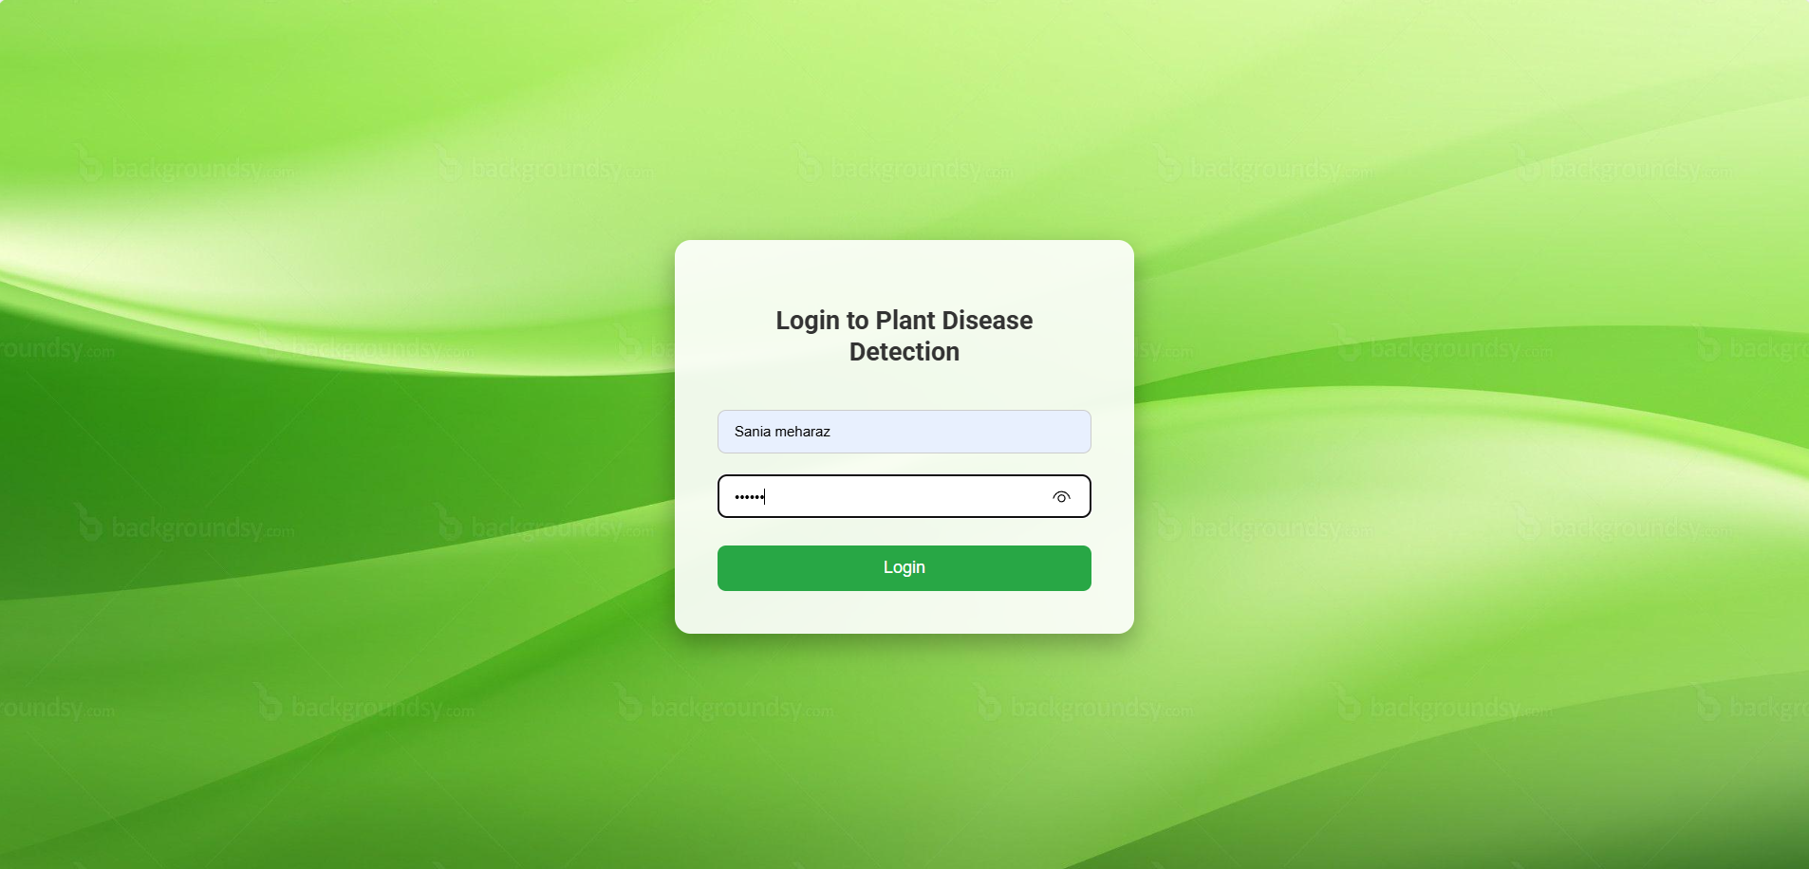

Slide 12
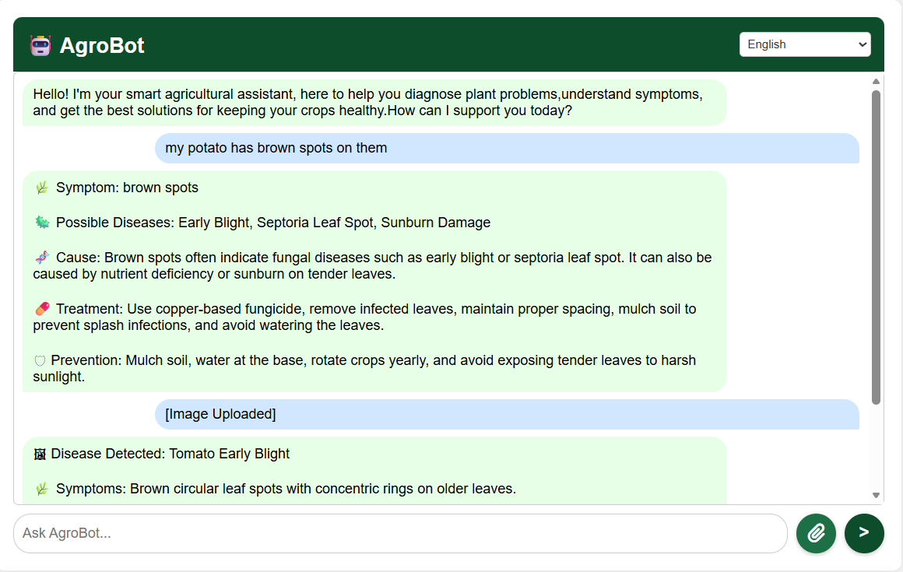

Slide 13
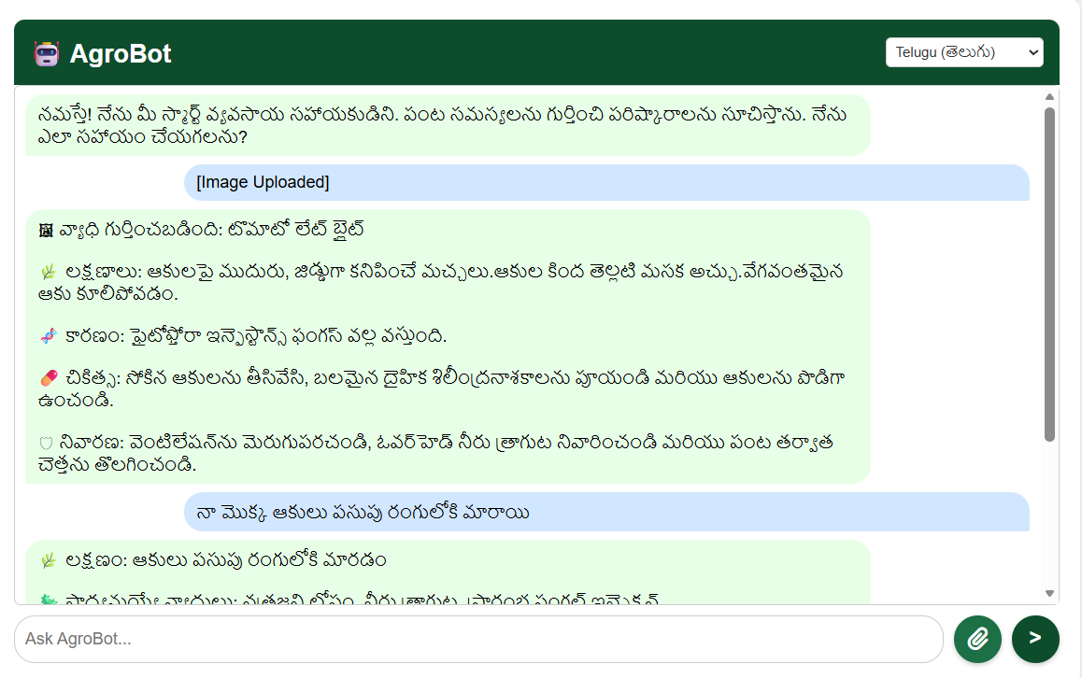

Slide 14
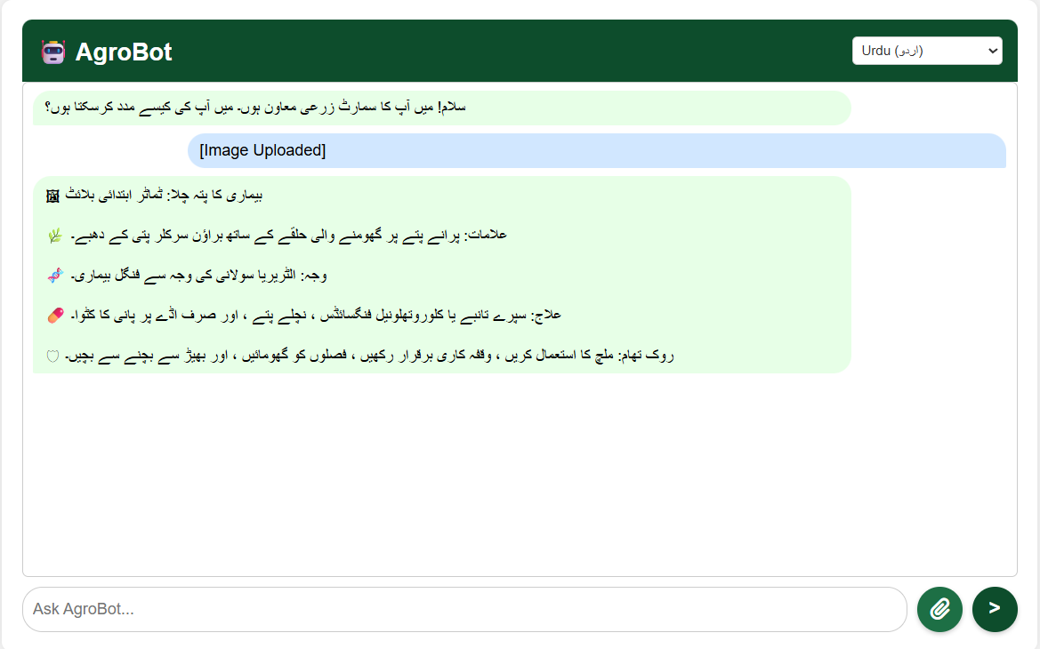

Slide 15
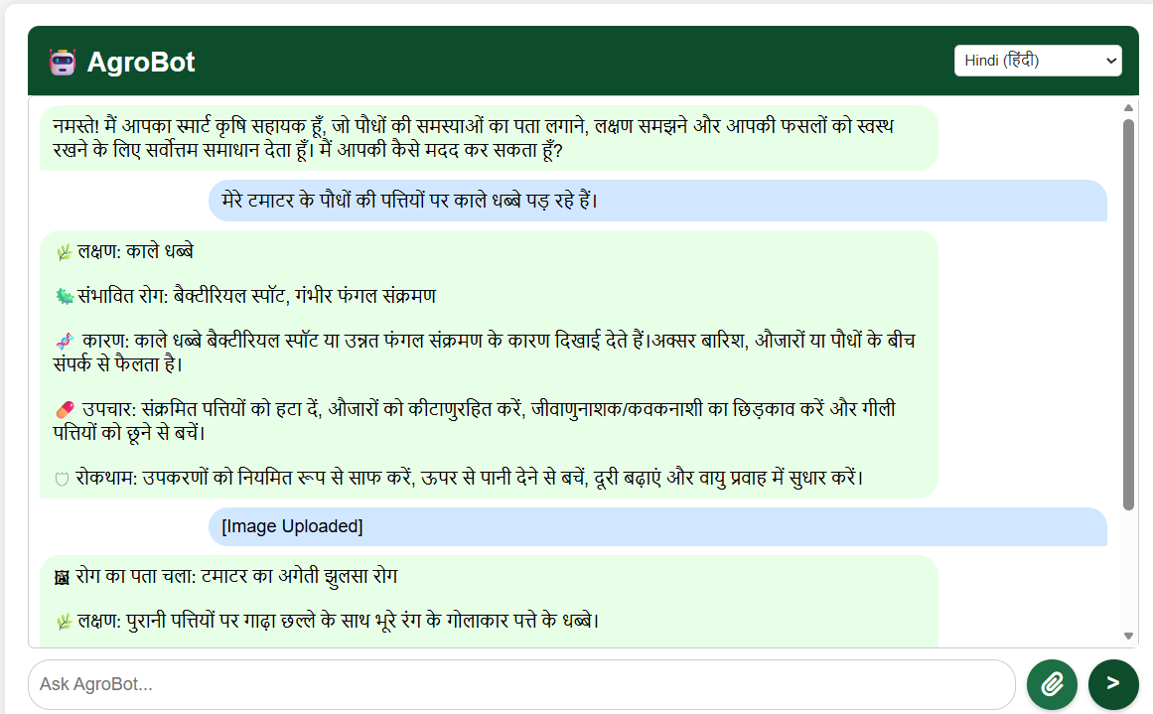

Slide 16
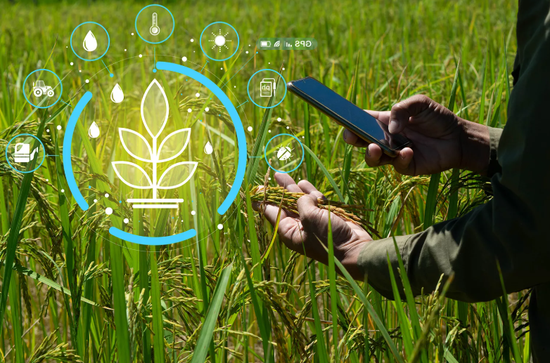
Conclusion
AgroBot successfully integrates CNN, NLP, and multilingual translation into a single agricultural assistance system
The model provides accurate crop disease detection from images
The NLP chatbot delivers reliable answers to farming-related queries
Multilingual support ensures accessibility for farmers across different regions and languages
The system offers a simple, fast, and user-friendly interface
Overall, AgroBot provides an effective and scalable solution for real-time agricultural guidance and disease diagnosis

Slide 17
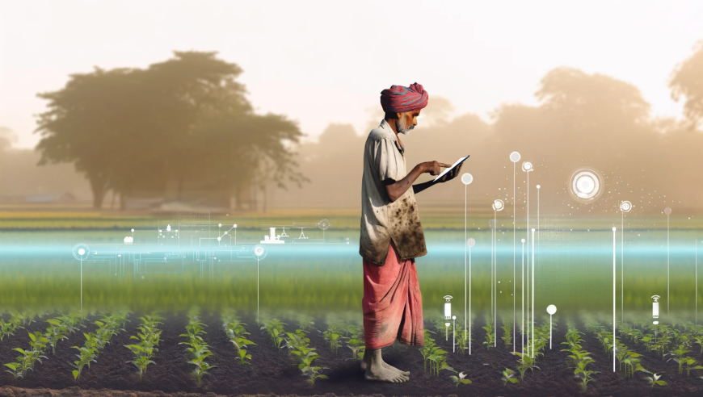
Future Scope
Integrate voice input and voice-based responses for hands-free interaction
Expand the crop image dataset to improve CNN accuracy and cover more plant species
Develop a mobile application for easier access in rural areas
Enhance NLP chatbot using advanced deep learning models.
Add real-time farm recommendations based on weather, soil, and fertilizer data
Implement an offline mode to support regions with limited internet connectivity
Introduce a farmer community feature for peer-to-peer support

Slide 18
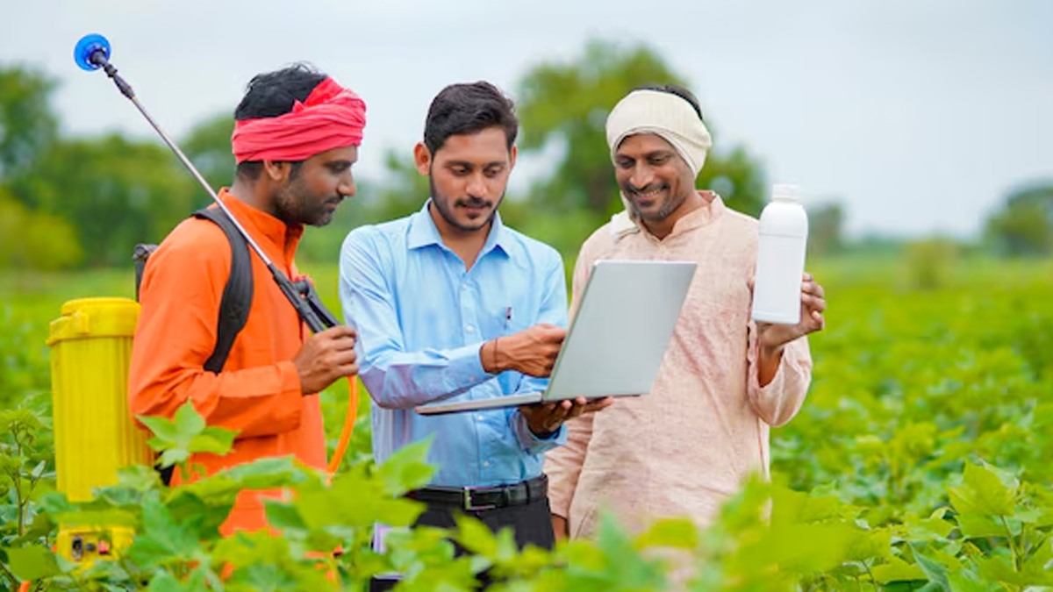
THANK YOU !

